Slide 1
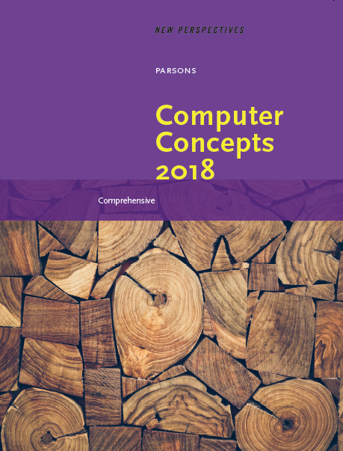

Computer Concepts 2018
Module 8
The ICT Industry
© 2019 Cengage. All rights reserved.

Slide 2
Module Contents
Section A: ICT Industry Basics
Section B: The Computer Industry
Section C: The Telecom Industry
Section D: Tech Careers
Section E: ICT Laws and Ethics

Slide 3
Section A: ICT Industry Basics
ICT Core Industries
ICT Goods and Services
Technology Life Cycles
Disruptive Technology
ICT and Productivity
ICT and National Security

Slide 4
Section A: Objectives (1 of 2)
List six core ICT industry components and provide examples of businesses in each
List four reasons why the ICT industry is one of the world’s largest economic sectors
Draw a timeline showing stock market trends for the ICT industry through boom and bust cycles between 1988 and the present year
Give at least three examples of ICT consumer goods and three examples of ICT capital goods
Distinguish between outsourcing and offshoring

Slide 5
Section A: Objectives (2 of 2)
Explain how Moore’s law is related to the declining price of ICT products
Draw diagrams representing the product life cycle, Rogers’ bell curve, and the Gartner Hype Cycle
Summarize the global influence of ICT
Provide at least three examples of disruptive technologies and explain their benefits as well as their drawbacks
List four of the six national security functions provided by the ICT industry
Explain the connection between cyberwarfare and the Tallinn Manual

Slide 6
ICT Core Industries (1 of 5)
As the computer industry expanded beyond number crunching to data storage and decision support, the IT (Information Technology) industry evolved
The ICT industry is a result of that evolution; a convergence between the IT industry and the telecommunications industry
Companies and businesses create jobs, develop products, and offer services that drive the economy; they are classified into economic sectors according to the types of goods and services they provide

Slide 7
ICT Core Industries (2 of 5)
The information industry has three major facets: content, computers, and telecommunications
The focus of Unit 8 is the ICT industry, which is made up of businesses that focus on digital equipment, software, and communications technologies

Slide 8
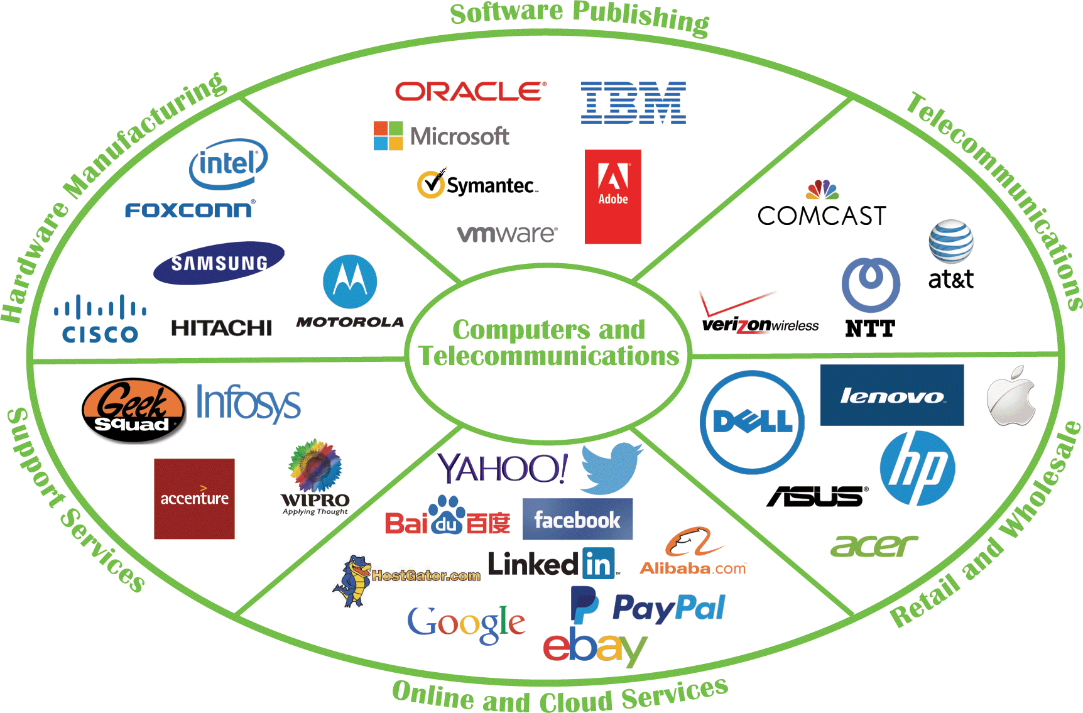
ICT Core Industries (3 of 5)

Slide 9
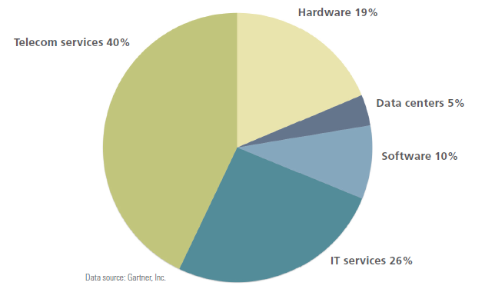
ICT Core Industries (4 of 5)
ICT is one of the world’s largest economic sectors; revenues exceed those of the oil and gas industry and the world’s airlines

Slide 10
ICT Core Industries (5 of 5)
The ICT industry has fueled the economies of many countries and was not as deeply affected as some sectors of the economy during the 2009 global recession
The so-called dot-com bubble was fueled by a frenzy of online business startups called dot-coms
A dot-com bubble that began in the late 1990s burst with devastating effects on ICT stock values; a stock market bubble refers to a sharp rise in stock values that is later followed by a sudden decline

Slide 11
ICT Goods and Services (1 of 5)
In economics, goods are things that can be used or consumed, whereas services are intangible actions performed for a consumer
ICT goods and services can be distributed locally, nationally, or internationally and are purchased by individuals and corporations
Consumer goods, such as laptops, are purchased by individuals; capital goods are raw materials used by businesses to make consumer goods

Slide 12
ICT Goods and Services (2 of 5)
The terms outsourcing and offshoring are often used interchangeably, but they are slightly different
Outsourcing is the use of components or labor from outside suppliers
Offshoring relocates business processes, such as manufacturing and customer support, to lower-cost locations in other countries

Slide 13
ICT Goods and Services (3 of 5)
Until the 1990s, ICT companies performed all phases of product development in house
Prototyping and mass production moved to Taiwan, then to China
Outsourcing and manufacturing efficiencies contributed to falling prices of ICT goods and services

Slide 14
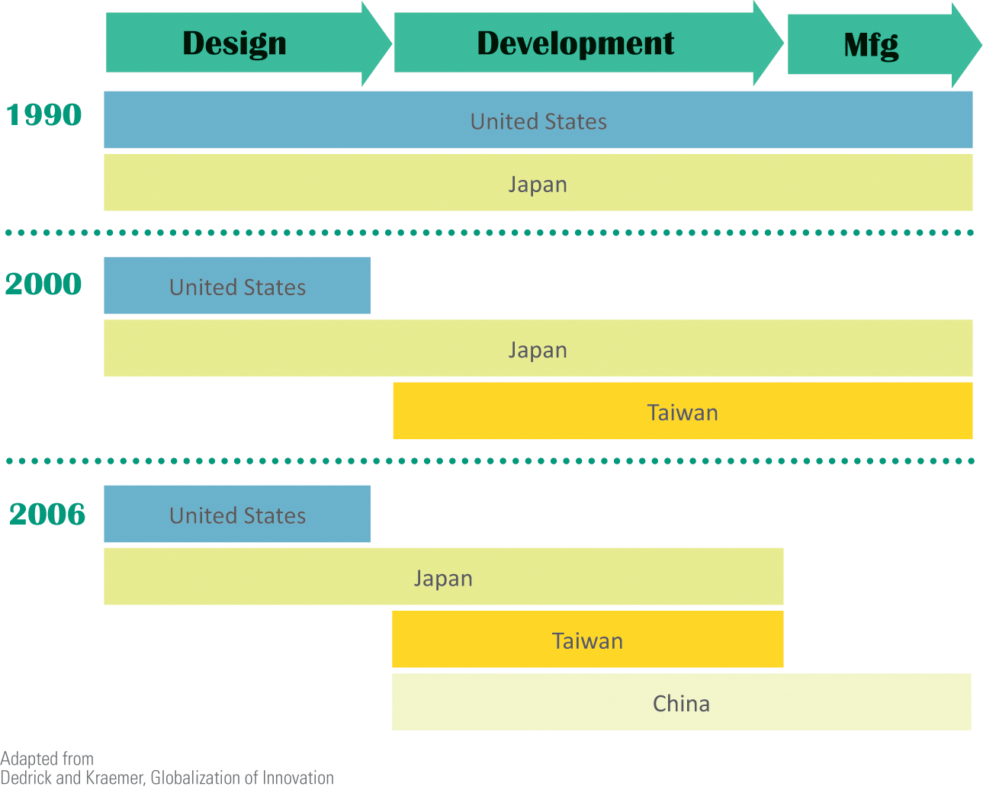
ICT Goods and Services (4 of 5)

Slide 15
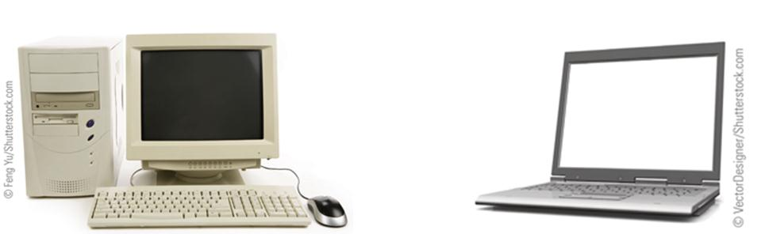
ICT Goods and Services (5 of 5)
In 1995, $1,800 purchased a desktop computer with a 33MHz processor, 8MB of RAM, a 200 MB hard disk, a CD drive, and a bulky CRT monitor with a maximum 1024×768 resolution.
In 2015, $500 paid for a laptop computer with a 1.7Ghz processor, 4GB RAM, a 500 GB hard disk, and an integrated 15” screen with a maximum 1600×900 resolution.

Slide 16
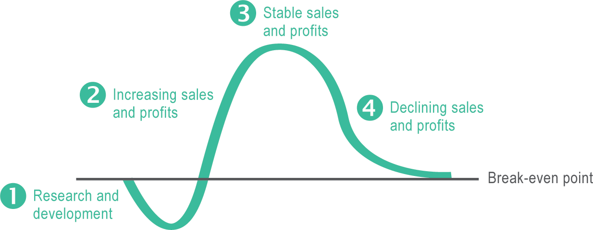
Technology Life Cycles (1 of 3)
The product life cycle (PLC) maps the expected profitability of a product from its inception to its demise

Slide 17
Technology Life Cycles (2 of 3)
To try and track a product’s life cycle, analysts and sociologists devised the following:
Moore’s law – Gordon Moore, co-founder of Intel Corp., predicted that technological innovation would double the number of transistors in an integrated circuit every two years without raising its cost
Rogers’ bell curve – frequently used to describe patterns in the way consumers adopt technology products; developed by a team of sociologists including Everett M. Rogers
Gartner Hype Cycle – represents the position of a product during its life cycle of publicity or “hype”; developed by analysts at Gartner, Inc.

Slide 18
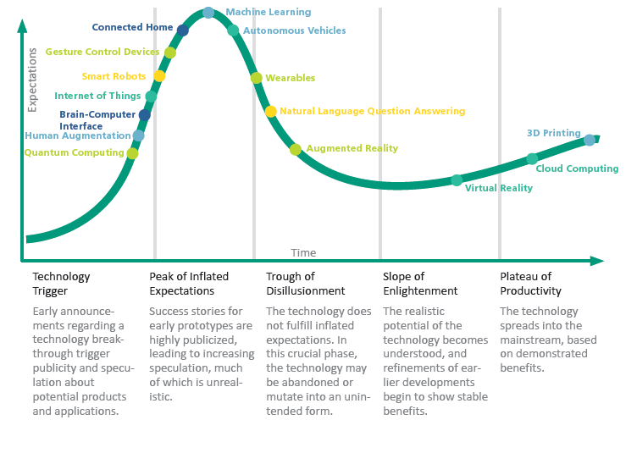
Technology Life Cycles (3 of 3)

Slide 19
Disruptive Technology (1 of 2)
Disruptive technology displaces an existing business process, market, industry, or product
Flat-screen LCD technology replaced CRT displays.
Digital photography replaced film photography, which affects camera manufacturers, film manufacturers, and photo processing shops.
Computers with word processors replaced typewriters.
Digital publishing and Web-based access to information have had a devastating effect on newspapers.

Slide 20
Disruptive Technology (2 of 2)
Movies replaced radio as a form of entertainment. Movies were then disrupted by television, which in turn has been disrupted by download and streaming technology.
The telegraph was disrupted by the tele­phone system, long distance by VolP, and land line service by cellular service.
Smartphones have the potential to replace devices such as MP3 players, portable game consoles, point-and-shoot cameras, personal video players, voice recorders, handheld GPS devices, wristwatches, paper maps, and handheld calculators.

Slide 21
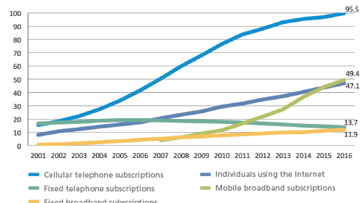
ICT and Productivity (1 of 4)
In the context of economics, productivity is a measurement of the amount of output that is produced per unit of input

Slide 22
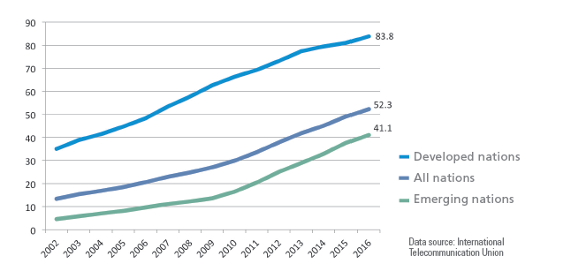
ICT and Productivity (2 of 4)

Slide 23
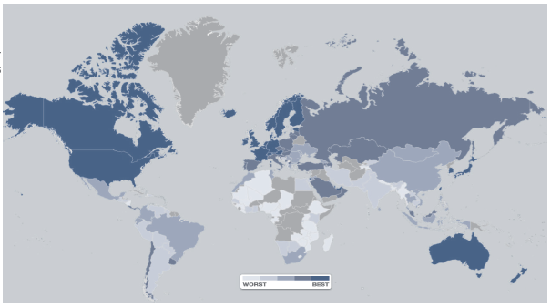
ICT and Productivity (3 of 4)
The World Economic Forum produces an annual report on the global influence of the ICT industry and identifies how well countries leverage ICT technologies

Slide 24
ICT and Productivity (4 of 4)
Economists use indicators, such as GDP (gross domestic product), to measure the total output of a nation
Between 2011 and 2013 digitization boosted world economic output by US$193 billion and created 6 million jobs during that period
These factors are a compelling argument for national investment in digital technologies

Slide 25
ICT and National Security (1 of 4)
Programs of surveillance, espionage, and sabotage are carried out today using cyberwarfare hacking tools
The ICT industry plays a major role in national security for countries throughout the world
Infiltrating and disabling computers storing sensitive corporate, government, or military data could create chaos and temporarily weaken military defenses

Slide 26
ICT and National Security (2 of 4)
Jam communications satellites | Pilots, ship captains, and military units rely on satellite-based GPS, communications, surveillance, navigation, and missile warning.
Shut down power grids including nuclear generators | Massive power outages can disrupt military defense operations and cause civilian chaos.
Disrupt air traffic control | Without air traffic control systems, flights are grounded.
Shut down water and fuel pipelines | A lack of water and fuel creates chaos, especially in major cities.
Disrupt financial assets such as banking networks and the stock market | Without banking networks, consumers cannot obtain cash or make credit card purchases.
Cut off Internet access with DDoS attacks | Both civilian and military communications can be cut off during a massive DDoS attack.
Industrial espionage | Cyber break-ins at companies that develop military weaponry are especially dangerous.
Interfere with SCADA control devices | Malware that randomly targets SCADA devices can shut down power plants, dams, and manufacturing facilities.

Slide 27
ICT and National Security (3 of 4)
The U.S. Department of Homeland Security identifies six national security functions supplied by the ICT sector:
Provide ICT products and services, such as servers, computers, and routers that are used in military and civilian installations
Provide incident management capabilities
Provide domain name resolution services
Provide identity management and trust support services
Provide Internet-based content, information, and communications services
Provide Internet routing, access and communications services

Slide 28
ICT and National Security (4 of 4)
Cyberwarfare is the use of ICT technology to carry out politically motivated attacks designed to infiltrate, sabotage, or damage an opponent’s information systems and defensive capabilities
Recent examples of cyberwarfare include the Stuxnet virus that disabled Iranian nuclear centrifuges
The international, non-binding document called the Tallinn Manual is a cyber equivalent of the Geneva Convention; it sets out rules for conducting and responding to cyberwarfare

Slide 29
Section B: The Computer Industry
Manual Calculators
Mechanical Calculators
Computer Prototypes
Commercial Computers
Personal Computers

Slide 30
Section B: Objectives (1 of 2)
Explain how algorithms apply to manual and mechanical calculators
Name five mechanical calculators that were significant innovations leading to the first computer technology
List five prototype computers and describe how their technology contributed to the technology used in modern-day computers
List the key hardware and software developments during the first, second, third, and fourth computer generations
Define von Neumann architecture

Slide 31
Section B: Objectives (2 of 2)
Describe the hobbyist phase of the personal computer era
List key hardware devices in the emerging personal computer era

Slide 32
Manual Calculators (1 of 2)
A manual calculator is a device that assists in the process of numeric calculations but requires the human operator to keep track of the algorithm
An algorithm is the step-by-step process by which numbers are manipulated; even simple paper-and-pencil addition requires an algorithm
A manual calculator called an abacus was used in ancient Rome, Greece, India, China, and Japan; only as the last century came to a close was the abacus replaced by handheld digital calculators

Slide 33
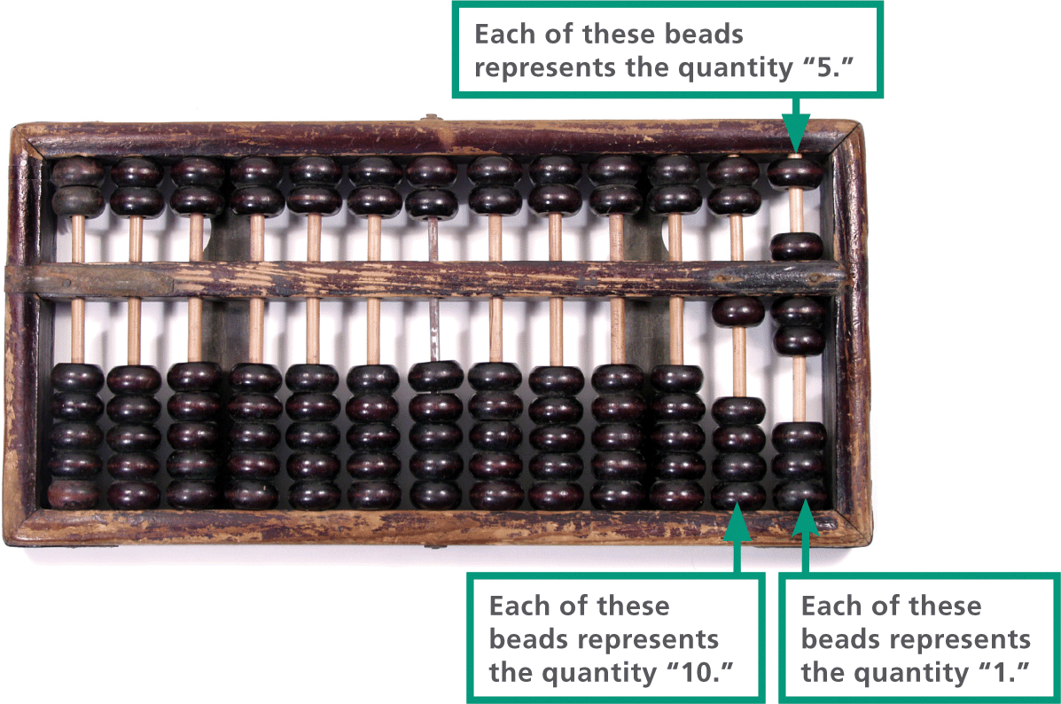
Manual Calculators (2 of 2)

Slide 34
Mechanical Calculators (1 of 4)
A mechanical calculator implements algorithms autonomously
Mechanical calculators were developed as early as 1623
Schickard’s Calculator had a series of interlocking gears; each of the ten spokes on a gear represented a digit; every time a gear completed a full circle, it moved the next gear one notch to the left to “carry the 1”
In 1642, a Frenchman named Blaise Pascal developed the Pascaline, a mechanical device that could be used to perform basic arithmetic

Slide 35
Mechanical Calculators (2 of 4)
Thomas de Colmar’s Arithmometer became the first mass-produced mechanical calculator
Charles Babbage’s Analytical Engine was an all-purpose computing device; historians believe that its design embodies many of the concepts that define modern computers, including:
Memory
A programmable processor
An output device
User-definable input of programs and data

Slide 36
Mechanical Calculators (3 of 4)
In 1890, Herman Hollerith won the U.S. Census Bureau’s competition to find a way to tabulate the census
Hollerith won the competition with a design for an electronic punched card tabulating device
The device used cards with designated areas representing data fields, such as “nationality”; once punched, the cards were fed into a reader that used an array of metal rods to electronically read data from the cards, tabulate the results, and display them on a series of dials

Slide 37
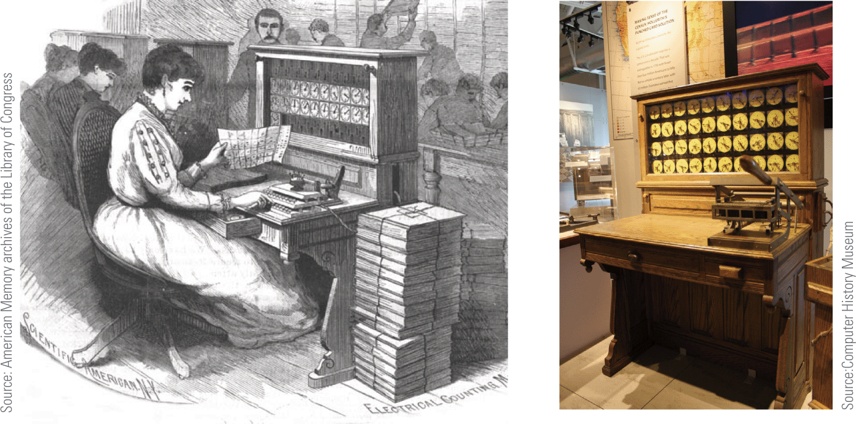
Mechanical Calculators (4 of 4)
Hollerith incorporated the Tabulating Machine Company in 1896; in 1924, the name was changed to International Business Machines—better known as IBM

Slide 38
Computer Prototypes (1 of 4)
Figuring out who invented the computer isn’t easy because modern digital computers evolved from prototypes developed between 1936 and 1946 by various individuals and teams
The Atanasoff-Berry Computer (ABC) was the first computing device to use vacuum tubes instead of mechanical switches as processing circuitry
Its design also incorporated the idea of basing calculations on the binary number system
Even though the ABC is often considered the first electronic digital computer, the work of its inventor was largely ignored

Slide 39
Computer Prototypes (2 of 4)
Other computer prototypes followed:
Z3 used vacuum tubes and was designed to work with binary numbers; built in Nazi Germany during World War II
Harvard Mark I officially named the IBM Automatic Sequence Controlled Calculator; used decimal rather than binary representation, which is used by today’s computers
Colossus developed in 1943 by British engineers; an electronic device designed to decode intercepted messages that were sent from the Nazi High Command to field officers

Slide 40
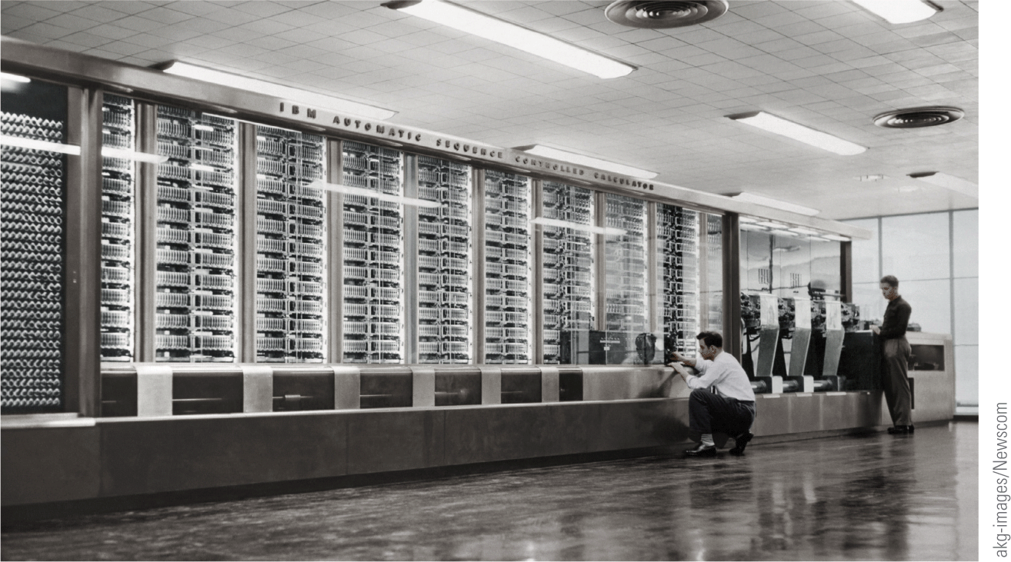
Commercial Computers

Slide 41
Computer Prototypes (3 of 4)
ENIAC (Electronic Numerical Integrator and Computer) was designed for the U.S. Army during WWII, but wasn’t finished until three months after the war ended
ENIAC was over 100 feet long and 10 feet high and weighed 30 tons!
Containing over 18,000 vacuum tubes and consuming over 174,000 watts of power, it was programmed by manually connecting cables and setting 6,000 switches—a process that usually took two days to complete
ENIAC’s memory held both programs and data. This feature became known as von Neumann architecture after the mathematician, John von Neumann

Slide 42
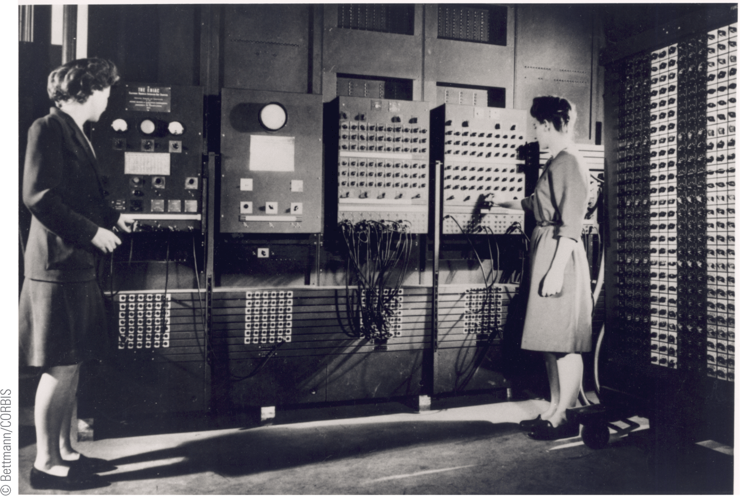
Computer Prototypes (4 of 4)
ENIAC’s first programmers were a team of six women

Slide 43
Commercial Computers (1 of 5)
A computer called UNIVAC is considered by most historians to be the first commercially successful digital computer
At 14.5 feet long, 7.5 feet high, and 9 feet wide, UNIVAC was physically smaller than ENIAC but more powerful
As technology evolved, relay switches and vacuum tubes were replaced with smaller, less power-hungry components

Slide 44
Commercial Computers (2 of 5)
First-generation computers, such as UNIVAC, can be characterized by their use of vacuum tubes to store individual bits of data
A vacuum tube is an electronic device that controls the flow of electrons in a vacuum
Each tube can be set to one of two states; one state is assigned a value of 0 and the other a value of 1

Slide 45
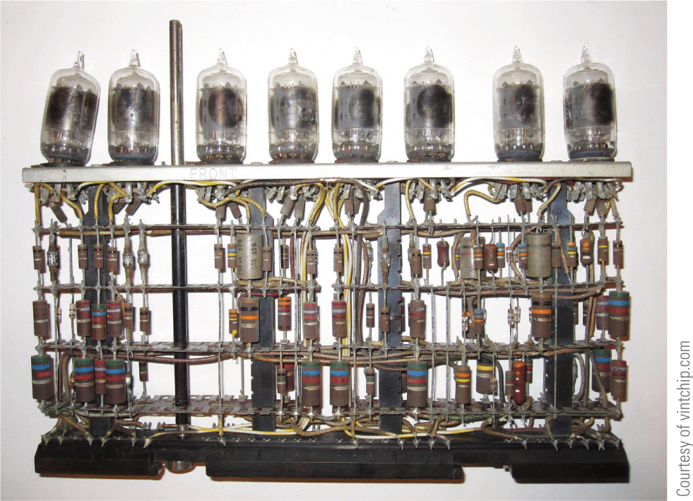
Commercial Computers (3 of 5)

Slide 46
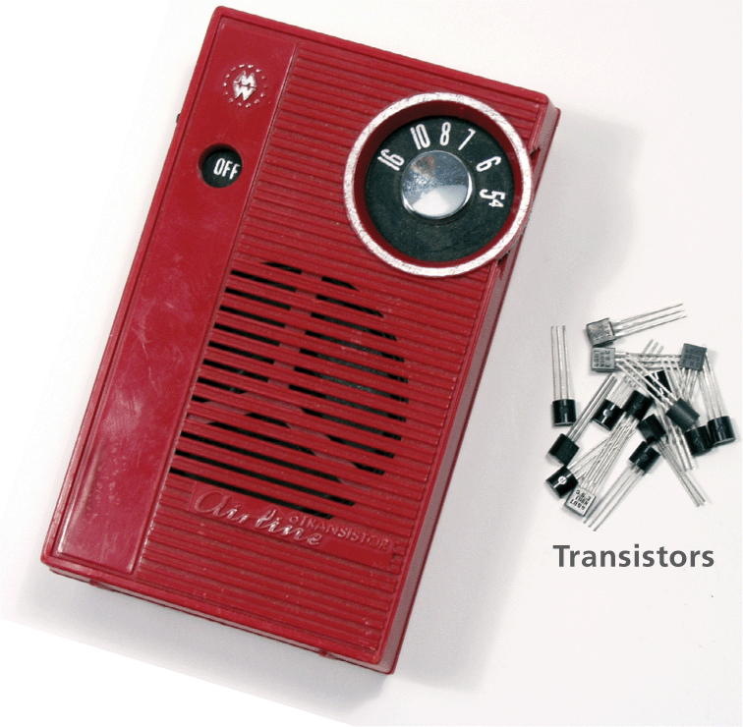
Commercial Computers (4 of 5)
Second-generation computers used transistors instead of vacuum tubes
Transistors regulate current or voltage flow and act as a switch for electronic signals
Transistors performed functions similar to vacuum tubes, but they were much smaller, cheaper, less power-hungry, and more reliable

Slide 47
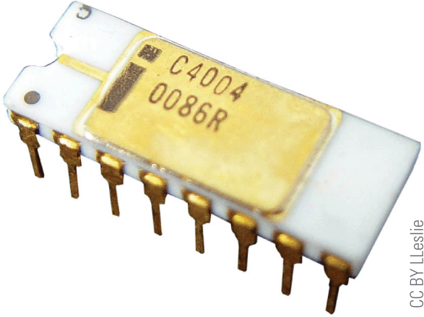
Commercial Computers (5 of 5)
Third-generation computers became possible in 1958, when integrated circuits were developed
IBM 360 offered integrated circuit technology; the first orders for these computers were filled in 1965
Fourth-generation computers appeared in 1971 with the development of the first general-purpose microprocessor called the Intel 4004
Intel’s 4004 was smaller than a cornflake but matched the computing power of ENIAC

Slide 48
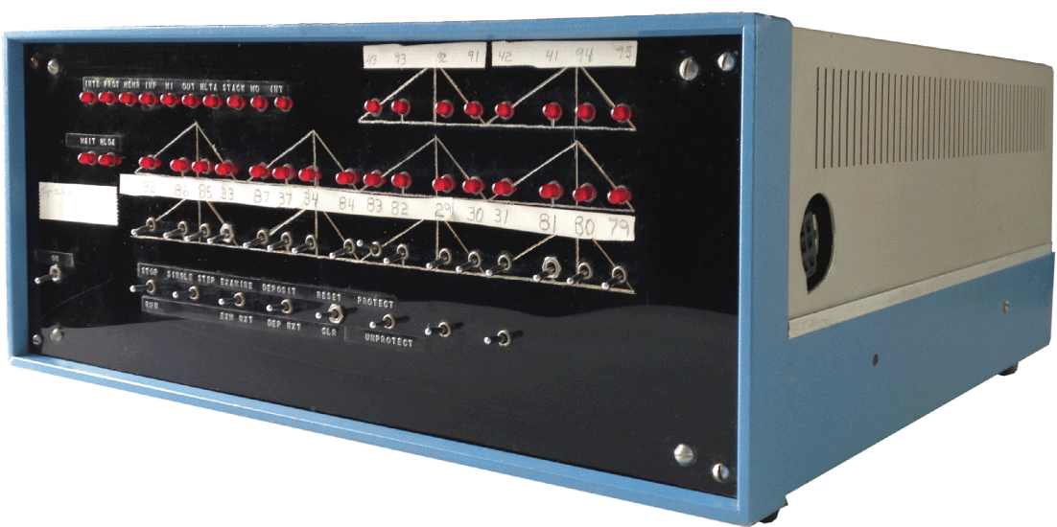
Personal Computers (1 of 6)
In the 1970s, many hobbyists built their own computer systems based on integrated circuit and microprocessor technologies
The Mark-8 and the MITS Altair were some of the first personal computers to be developed
The Altair was sold as a kit for $395; it had no keyboard, no monitor, and no permanent storage device

Slide 49
Personal Computers (2 of 6)
In 1976 Apple Computer Co. was founded by Steve Jobs and Steve Wozniak
Apple released several computers during the 1970s and 1980s, including:
Apple I – a kit containing a system board with 4 KB of RAM that sold for $666.66
Apple II – featured color graphics, expansions slots, a disk drive, a 1.07 MHz 6502 processor, and 16 KB of RAM for $1,195

Slide 50
Personal Computers (3 of 6)
Apple Lisa – introduced in 1983, it made computers even easier for the average person to use; its key feature was a graphical user interface; at $10,000 it proved too expensive for most consumers
Apple Macintosh – featured a graphical user interface; it became the computer of choice for desktop publishing; cost was $2,495

Slide 51
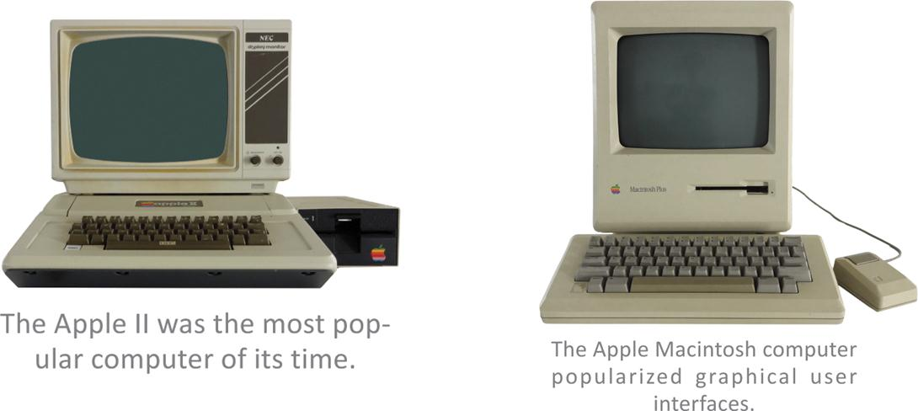
Personal Computers (4 of 6)

Slide 52
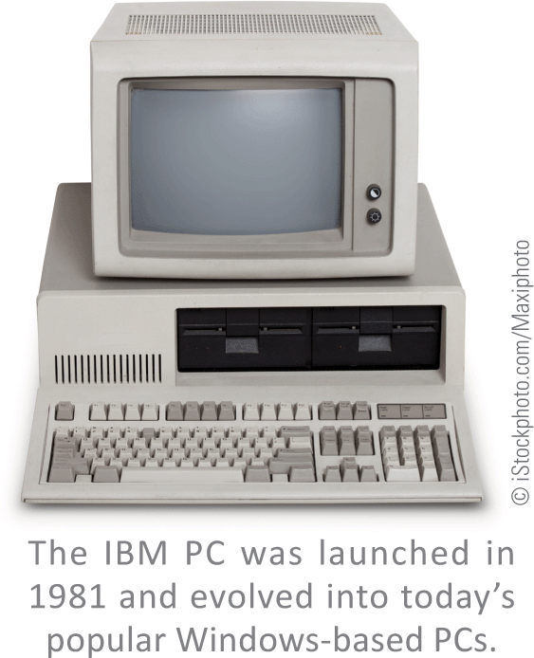
Personal Computers (5 of 6)
In 1981, IBM began marketing what it called a personal computer or PC
The $3,000 IBM PC had a 4.77 MHz Intel 8088 processor, 16 KB of RAM, and floppy disk drives
The operating system used on these computers was called PC-DOS and was created by a young entrepreneur named Bill Gates

Slide 53
Personal Computers (6 of 6)
1950-1980
Big computers for big business
1980-2010
Big computers for big business
Desktops and laptops for business and personal use
2010-Future
Big computers for big business
Desktops and laptops for business and personal use
Handheld devices for personal use

Slide 54
Section C: The Telecom Industry
Telegraph
Telephone
Radio
Cellular Phones
Television

Slide 55
Section C: Objectives (1 of 2)
List six technologies in the telecommunications sector in the order they were invented
Sketch a timeline of key events in the evolution of the telegraph and show how they relate to the Gartner Hype Cycle
Explain the concept of common carrier, and list the communications industries that are included in this classification
Explain how the telephone industry evolved into a significant component of the Internet backbone

Slide 56
Section C: Objectives (2 of 2)
Describe at least two contributions that the radio industry made to modern telecommunications
List the major characteristics that differentiate 1G, 2G, 3G, and 4G cellular service
Sketch a timeline of key events in the television industry and explain how they affect modern Internet access

Slide 57
Telegraph (1 of 2)
Telegraphy refers to transmitting text or symbolic information over long distances without the use of a living carrier
The telegraph was built in 1816 using a cable connected at either end to dials marked with the letters of the alphabet
In 1837, U.S. inventor Samuel Morse developed a telegraph system that transmitted data using his Morse code alphabet, a binary encoding system based on dots and dashes

Slide 58
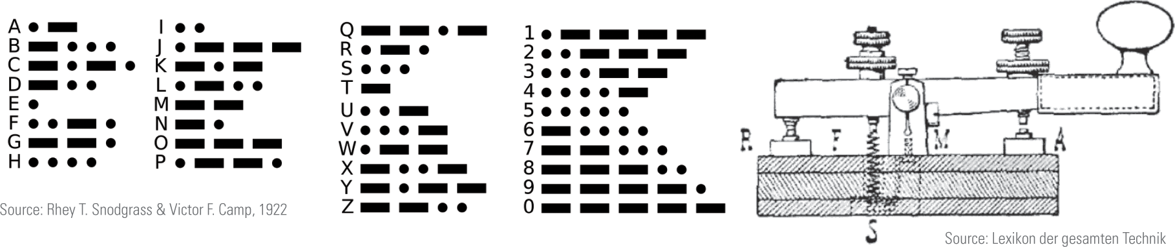
Telegraph (2 of 2)

Slide 59
Telephone (1 of 3)
A telephone is, very simply, a device that transmits human voices over a distance using cables or airborne signals
The first telephone was invented and patented by Alexander Graham Bell in 1876
Telephones evolved through several design form factors, including box phones and phones with rotary dialers

Slide 60

Telephone (2 of 3)
1890-1910
Early box phones had no dialing mechanism. Turning the crank alerted the operator, who would ask for the number.
1890-1930
Candlestick telephones separated the microphone/transmitter from the speaker/receiver.
1940-1970
Rotary telephones included a rotary dialer; the handset included both a speaker and a microphone.
1960-2010
Trimline telephones introduced touch-tone dialing in 1963.

Slide 61
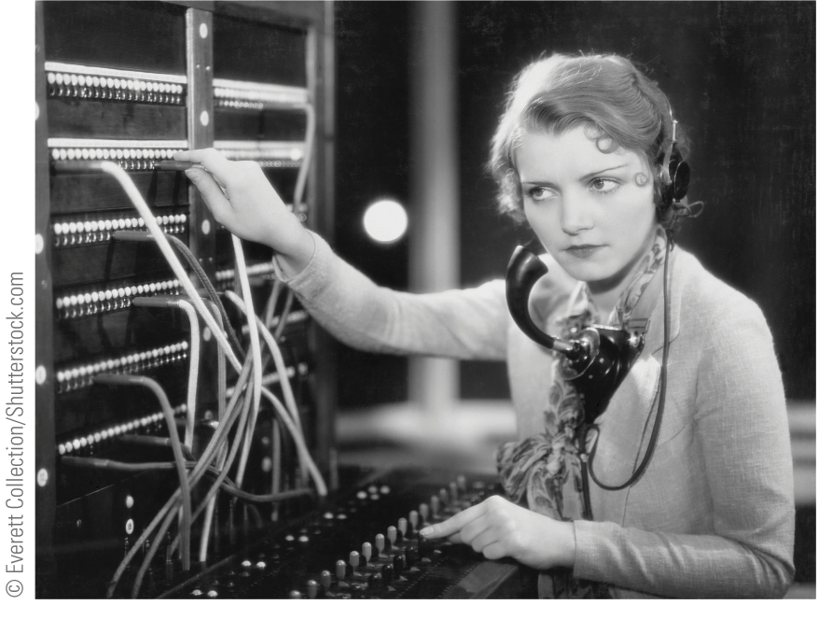
Telephone (3 of 3)
A telephone exchange managed connections between callers
The world’s first commercial telephone exchange opened in 1877, in Germany
Its manual switch board was controlled by a switchboard operator
Automated exchanges, developed in 1900, eliminated the need for human operators
A common carrier is any person or company that transports goods, passengers, or electronic signals over regular routes at set rates

Slide 62
Radio
A radio is a device that sends and receives sound as electromagnetic waves
Like computers, radios originally used vacuum tubes but moved on to new technologies like the transistor
Radio technology is the basis for cell phones, Wi-Fi, Bluetooth, and near-field communications (NFC)—all indispensible tools of the digital age

Slide 63
Cellular Phones (1 of 4)
A cellular telephone is a device that uses a low-power radio transmitter to carry out two-way voice communications
Two-way radio technology went portable during WWII
In 1984 Motorola brought to market the first cell phone model named the Motorola DynaTAC 8000X; it weighed almost 2 pounds and was more than 12 inches long

Slide 64
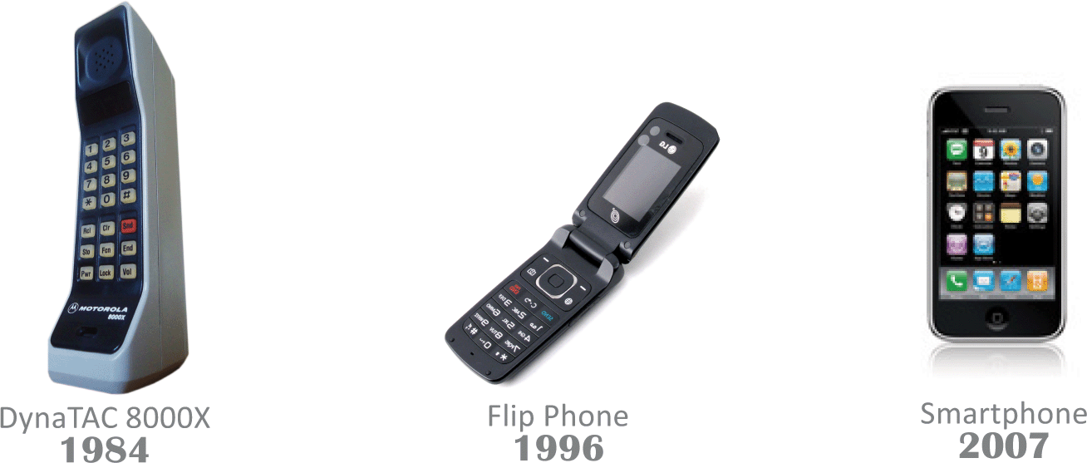
Cellular Phones (2 of 4)

Slide 65
Cellular Phones (3 of 4)
1G(1984)
Basic voice service
Analog-based protocols
2.4 kbps
2G(1991)
Designed for voice
Improved coverage and capacity
First digital standards(GSM, CDMA)
64kbps

Slide 66
Cellular Phones (4 of 4)
3G(2001)
Designed for voice with some data (multimedia, text, Internet)
First mobile broadband
2,000kbps
4G(2011)
Designed primarily for data
IP-based protocols(LTE)
True mobile broadband
100,000kbps

Slide 67
Television (1 of 2)
Television is a technology designed to send moving images over a distance
Beginning with black-and-white sets, televisions progressed to colored programming and eventually transitioned to digital television (DTV)
Pay television is a popular subscription service in which consumers pay to receive a selection of television channels

Slide 68
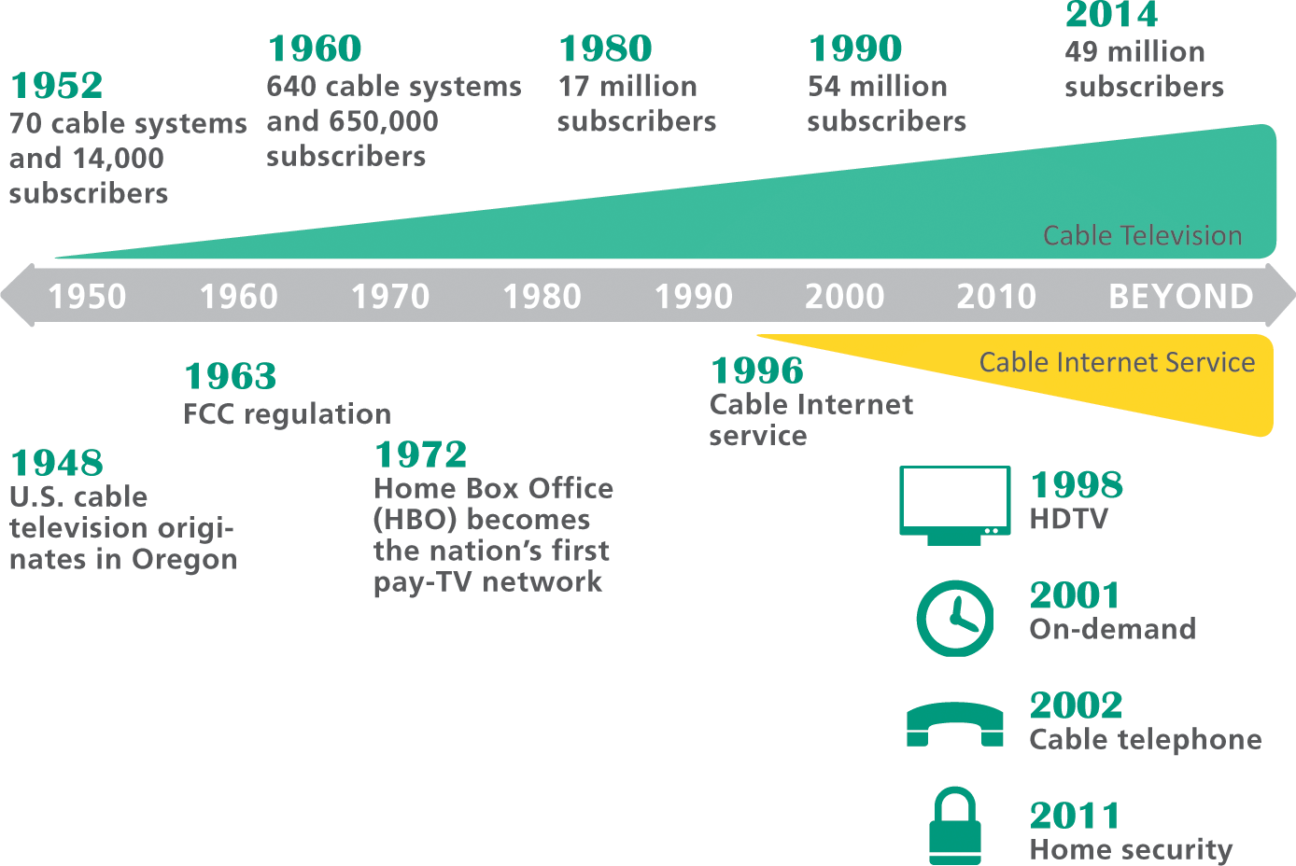
Television (2 of 2)

Slide 69
Section D: Tech Careers
Jobs and Salaries
Education
Certification
Resumes

Slide 70
Section D: Objectives (1 of 2)
Differentiate between tech sector, STEM, and computer industry careers
List at least seven occupations within a typical IT department
Give an example of the titles used for various levels of career advancement in a tech job

Slide 71
Section D: Objectives (2 of 2)
Explain how contract workers differ from employees
List the five computing disciplines recognized by the ACM
Explain the relative merits of a college degree compared to certification, internships, badges, open source projects, and nanodegrees
List six resume formats, and describe when they are best used

Slide 72
Jobs and Salaries (1 of 12)
Tech sector careers are part of a broad set of information, technology, and communications industries
The classification technology workers encompasses jobs, such as:
Telephone cable installers
Radio broadcasters
Computer programmers
Web designers
Software developers

Slide 73
Jobs and Salaries (2 of 12)
A different classification of tech sector careers comes from STEM (science, engineering, technology, and math)
STEM is increasingly used to define an employment sector that includes jobs in:
Biology
Chemistry
Information Technology
Engineering
Math
Physics

Slide 74
Jobs and Salaries (3 of 12)
A third classification of tech sector careers focuses on computer professionals
A computer professional is anyone whose primary occupation involves the design, configuration analysis, development, modification, testing, or security of computer hardware or software
Many computer professionals work in an IT department—the wing of a business or organization responsible for computer, data, software, and support services; a chief information-officer (CIO) heads the IT department

Slide 75
Jobs and Salaries (4 of 12)
A systems analyst investigates the requirements of a business or an organization, its employees, and its customers in order to plan and implement new or improved computer services. This job requires the ability to identify problems and research technical solutions. Good communication skills are essential for interacting with managers and other employees.

Slide 76
Jobs and Salaries (5 of 12)
A computer programmer (sometimes described as a programmer/analyst) designs, codes, and tests computer programs. In addition, programmers modify existing programs to meet new requirements or eliminate bugs. Computer programming requires concentration and a good memory for the countless details that pertain to a programming project. Programming projects range from entertainment and games to business and productivity applications. Programmers get satisfaction from devising efficient ways to make a computer perform specific jobs, tasks, and routines.

Slide 77
Jobs and Salaries (6 of 12)
A security specialist analyzes a computer system’s vulnerability to threats from viruses, worms, unauthorized access, and physical damage. Security specialists install and configure firewalls and antivirus software. They also work with management and employees to develop policies and procedures to protect computer equipment and data. Computer security jobs are punctuated by crises when a virus hits or a security breach is discovered. A security specialist must have a wide-ranging knowledge of computers and communication protocols that can be applied for a quick resolution to any crisis that occurs.

Slide 78
Jobs and Salaries (7 of 12)
A database administrator analyzes a company's data to determine the most effective way to collect and store it. Database administrators create databases, data entry forms, and reports. They also define backup procedures, provide access to authorized users, and supervise the day-to-day use of databases.
A network administrator plans, installs, and maintains one or more local area networks and may also manage cloud resources. These specialists provide net­work accounts and access rights to approved users.

Slide 79
Jobs and Salaries (8 of 12)
They troubleshoot connectivity problems and respond to requests from network users for new software. Network administrators might be responsible for maintaining the security of a network, plus they often pick up Web master duties to maintain an organization's Web site.
A computer operator works with system software for network servers, mainframes, and supercomputers. Computer operators monitor computer performance, install software patches and upgrades, perform backups, and restore data as necessary.

Slide 80
Jobs and Salaries (9 of 12)
A technical support specialist troubleshoots hardware and software problems. Good interpersonal skills and patience are required for this job.
A Web site developer creates, tests, posts, and modifies Web pages. A good sense of design and artistic talent are required for this job, along with an understanding of how people use graphical user interfaces. Familiarity with Web tools, such as HTML and JavaScript, is becoming more important for this job, as is a knowledge of computer programming and database management.

Slide 81
Jobs and Salaries (10 of 12)
A social networking analyst manages an organization's online reputation by establishing and maintaining social media sites and evaluating analytics to support its mission. This occupation requires familiarity with social networking sites and an ability to interpret statistical metrics obtained from analytical tools.

Slide 82

Jobs and Salaries (11 of 12)
The U.S. Bureau of Labor and Statistics predicts that in the decade 2012–2022, employment in the information and technology sector could grow by 18%, generating 650,000 new jobs
An unknown number of these jobs will be outsourced, which may negatively affect U.S. workers but will benefit offshore workers

Slide 83
Jobs and Salaries (12 of 12)
Workers in many industries are interested in becoming a telecommuter who uses available technology to work from home or an off-site location
Telecommuters tend to be more productive and work longer hours because they have no commute time and are not interrupted by routine office chatter
Finding a job in the IT industry is similar to finding a job in most other industries
Use online job listing sites (Tech Jobs, ComputerJobs.com)
Network (in person or via email)
Use social networking tools (LinkedIn)

Slide 84
Education (1 of 4)
Computer science is only one of many computer-related degrees that colleges and universities offer
According to the Association for Computing Machinery (ACM), there are five major computing disciplines:
Computer engineering
Computer science
Information systems
Information technology
Software engineering

Slide 85
Education (2 of 4)
DEGREE | CURRICULUM | CAREERS
Computer engineering focuses on the design of computer hardware and peripheral devices, often at the chip level. | This degree involves basic studies in calculus,chemistry, engineering, physics, computer organization, logic design, computer architecture, microprocessor design, and signalprocessing. | Working at a chip manufacturer, such as Intel, Motorola, IBM, AMD, or Texas Instruments.
 | Students learn how to design new computercircuits, microchips, and other electroniccomponents, plus they learn how to designnew computer instruction sets and combineelectronic or optical components to providepowerful, cost-effective computing.
Computer science focuses on computer architecture and how to program computers to make them work effectively and efficiently. | This degree involves courses in programming, algorithms, software development, computer architecture, data representation, logic design, calculus, discrete math, and physics. | Computer programmers, with good possibilities for advancement to software engineers, object-oriented/ GUI developers, and project managers in technical applications development.

Slide 86
Education (3 of 4)
DEGREE | CURRICULUM | CAREERS
 | Students investigate the fundamental theories of how computers solve problems, and they learn how to write application programs, system software, computer languages, and device derivers. | Also, theorists, inventors, and researchers in fields as diverse as artificial intelligence, virtual reality, and computer games.
Information systems degree programs, typically offered by a university's college of business, focus on applying computers to business problems. | degree involves coursework in business, accounting, computer programming, communications, systems analysis, and human psychology. | Programming or technical support jobs, with good possibilities for advancement to systems analyst, project manager, database administrator, network manager, or other management positions.
 | This degree is recommended for students who want to become computer professionals but lack strong math aptitude.

Slide 87
Education (4 of 4)
DEGREE | CURRICULUM | CAREERS
Information technology degree programs focus on computer equipment and soft­ ware used by businesses. | This degree involves hands-on coursework with hardware, networks, Web pages, multimedia,email systems, and security. | Network specialists and administrators, systems analysts, forensic technicians, and help desk technicians.
Software engineering takes a disciplined approach to developing software that is reliable,efficient, affordable, user- friendly, and scalable. | This degree involves studying statistics, software design, programming, systems analysis and courses from information systems and computer science curricula. | Programmers, analysts, or managers on large-scale, safety-critical applications.

Slide 88
Certification (1 of 4)
Approximately 300 computer-related certification exams are offered in areas of specialty that range from desktop publishing to network installation
Certification exams can be divided into several categories, including the following:
General computer knowledge
Software applications
Database administration
Networking and cloud
Computer hardware
Computer security

Slide 89
Certification (2 of 4)
AP Exam
Students who pass the AP Computer Science exam in high school have a head start on their college-level courses and may increase their chances of acceptance into an elite computer science program.
Open Source Projects
Participants in open source community projects get experience and make con­nections with other professionals that can be valuable resources during a job hunt. You can find projects at GitHub, SourceForge, OpenHatch, and Open Hub.

Slide 90
Certification (3 of 4)
Internships
Internships are resume builders. Look for opportunities during summer break or for an after-school job. Working in the field before graduating adds relevant work experience to your list of qualifications.
Badges
Badges are inspired by videogame awards and Boy Scout patches. Online education providers, such as Khan Academy and OpenStudy, offer badges to students who complete various milestones.

Slide 91
Certification (4 of 4)
Nanodegrees
Nanodegrees are awarded upon completion of one or more targeted online courses. These offshoots of MOOCs (massive open online courses) offer self-study training to career-minded individuals who might not have the time or means to complete a traditional degree program.

Slide 92
Resumes (1 of 3)
Job seekers need to produce resumes in a variety of formats, including the following:
Print
Email
HTML
LinkedIn
Online job service
Web portfolio (a hypertext version of your resume)

Slide 93
Resumes (2 of 3)
Be clear and concise.
Eliminate unnecessary words, phrases, and sentences.
Be efficient with words when describing tasks, duties, titles, and accomplishments.
Be brief and to the point without selling yourself short.
Place the most Important point first.
List your qualifications by importance and relevance to the job you seek.
Summarize skills at the top of the resume.
Use a bold font to emphasize skills and accomplishments that are required for the position you seek.

Slide 94
Resumes (3 of 3)
Include pertinent information about training, certification, and professional affiliations, but avoid personal information, such as church affiliation and hobbies, that is not directly related to the job.
Use language effectively.
Target terms and wording to prospective employers.
Use industry jargon wherever appropriate.
Use action verbs to maintain the reader's interest.
Use past and present tenses consistently.
Double-check grammar and spelling.
When posting information in a database, use nouns that describe your skills.

Slide 95
Section E: ICT Laws and Ethics
ICT Laws
ICT Ethics
Ethical Decision Making
Whistleblowing

Slide 96
Section E: Objectives (1 of 2)
List at least five significant areas of information technology law
Explain the purpose of the following: Computer Fraud and Abuse Act, Electronic Communication Privacy Act, Communications Decency Act, Digital Millennium Copyright Act, and USA PATRIOT Act
Supply an example of an ethical dilemma that involves copyright
Supply examples of ethical dilemmas that involve privacy and confidentiality

Slide 97
Section E: Objectives (2 of 2)
Explain what technology professionals should consider before using resources at work for their personal projects
Explain the context in which technology professionals have social responsibility
List five resources for ethical decision making
Provide at least three examples of whistleblowing related to information technology
Explain the ethical dilemma faced by whistleblowers

Slide 98
ICT Laws (1 of 2)
Information technology law is the legal framework that applies to the collection, storage, and distribution of digital information
Some of the most significant areas of information technology law include the following:
Copyright and intellectual property
Domain names
Patents
Cybercrime
Software and computer contracts
Privacy
Communication

Slide 99
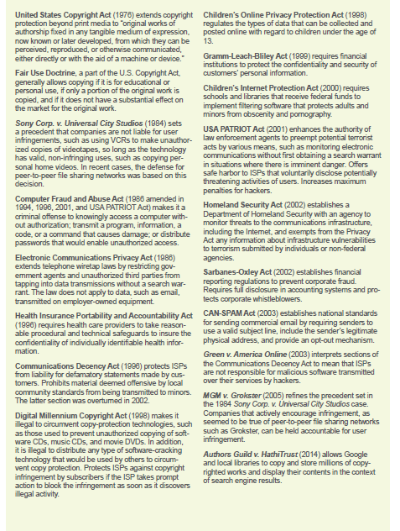
ICT Laws (2 of 2)

Slide 100
ICT Ethics (1 of 2)
The term professional ethics refers to on-the-job choices and actions that reflect a person’s values
Confidentiality is the obligation not to disclose willingly any information that should be kept private
Proprietary information includes knowledge about company finances, procedures, products, and research that competitors would find valuable
A non-compete clause is designed to prevent employees from divulging proprietary information to competitors

Slide 101
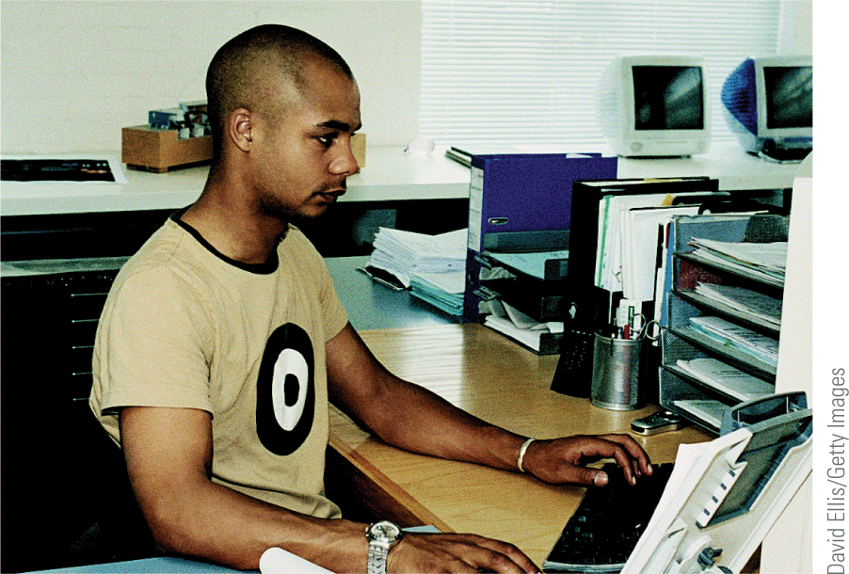
ICT Ethics (2 of 2)
It’s never a good idea to use facilities at work for personal activities unless you have a specific agreement with your employer and your activities do not breach your employment contract

Slide 102
Ethical Decision Making (1 of 3)
Ethical decisions that you make on the job can have long-term consequences for your career and lifestyle, so it is important to approach these decisions seriously
Use the following strategies when making decisions at work:
Talk to people whose judgment you respect
Consider what the most ethical person you know would decide to do
Think about what you would do if your actions were made public
Look at the problem from the opposite perspective
Consult a code of professional ethics

Slide 103
Ethical Decision Making (2 of 3)
A code of ethics is a set of guidelines designed to help professionals thread their way through a sometimes tangled web of ethical on-the-job decisions
Some codes of ethics are short and concise, whereas others are long and detailed
Most codes contain principles similar to those from the Computer Ethics Institute (CEI)
Do not use a computer to harm other people
Do not interfere with other people's computer work
Do not snoop around in other people's files

Slide 104
Ethical Decision Making (3 of 3)
Do not use a computer to steal
Do not use a computer to bear false witness
Do not use or copy software for which you have not paid
Do not use other people's computer resources without authorization
Do not appropriate other people's intellectual output.
Think about the social consequences of the programs you write
Use a computer in ways that show consideration and respect

Slide 105
Whistleblowing (1 of 3)
A widely accepted definition of whistleblowing is the disclosure by an employee (or professional) of confidential information that relates to some danger, fraud, or other illegal or unethical conduct connected with the workplace
A whistleblower is someone in an organization who decides to speak out against on-the-job activities that are contrary to the mission of the organization or threaten the public interest

Slide 106
Whistleblowing (2 of 3)
Employee advocates have the following suggestions for reducing the risk of career repercussions that are often experienced by whistleblowers:
Examine your motives
Try the normal chain of command
Collect evidence to back up your accusations
Record events as they unfold
Act ethically

Slide 107
Whistleblowing (3 of 3)
Be ready to accept repercussions
Establish a support network
Consult a lawyer
Consider your strategy

